Slide 1
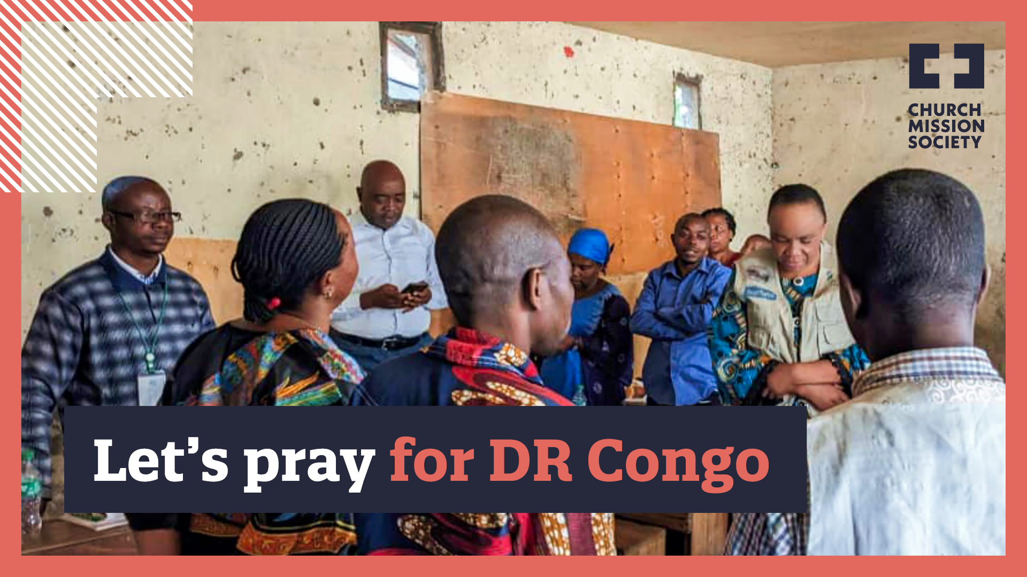

Slide 2
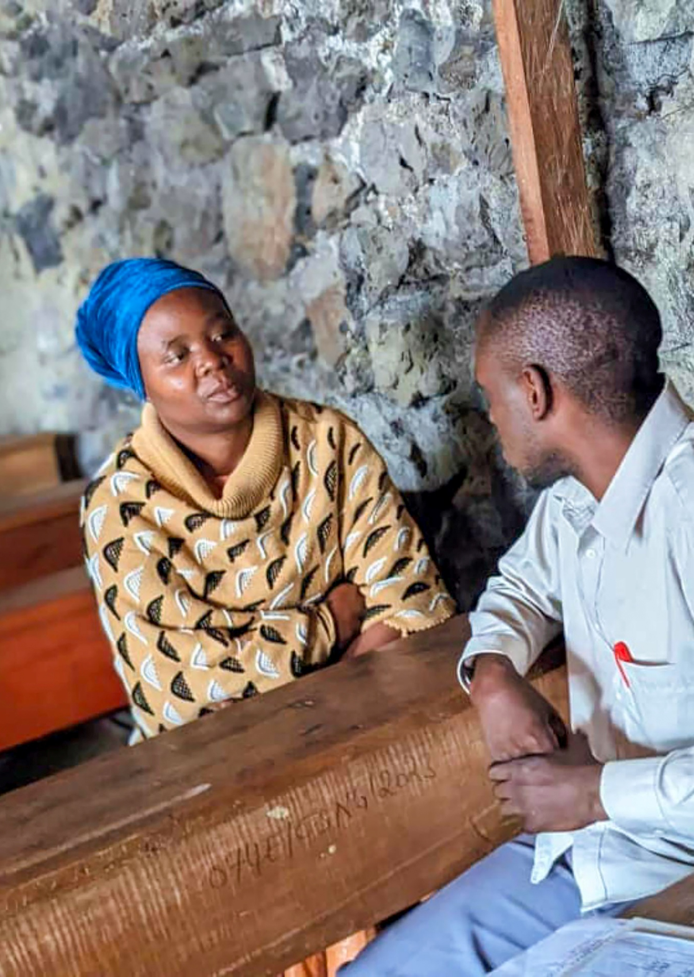
Let’s pray for DR Congo
For pastors as they shoulder much of the burden of caring for their communities
For the healing of deep wounds, for children to learn to play again
For sharing Jesus in new places and for new churches being planted
For good to overcome evil, and
for peace to come to Goma and
DR Congo

Slide 3
A liturgy for peace in DR Congo
Through Jesus, we are to heal what is broken, to restore what is lost, and to reconcile those who are divided.
Standing alongside our brothers and sisters across the world, we pray for peace.

Slide 4
A liturgy for peace in DR Congo
In our hearts, minds and souls,
Give peace in our time, O Lord.
In our homes, families and communities,
Give peace in our time, O Lord.
In our nation, and in all nations of the world,
Give peace in our time, O Lord.

Slide 5
A liturgy for peace in DR Congo
In all areas of war, violence and conflict,
Give peace in our time, O Lord.
Where there is hatred, division and discord,
Give peace in our time, O Lord.

Slide 6
A liturgy for peace in DR Congo
We pray especially for Goma and for the whole of DR Congo - For peace and for
peacemakers, For healing and reconciliation,

Slide 7
A liturgy for peace in DR Congo
For the strength not to be overcome by evil, but to overcome evil with good,
And for all those who seek to walk in the path of peace,
Give peace in our time, O Lord.

Slide 8
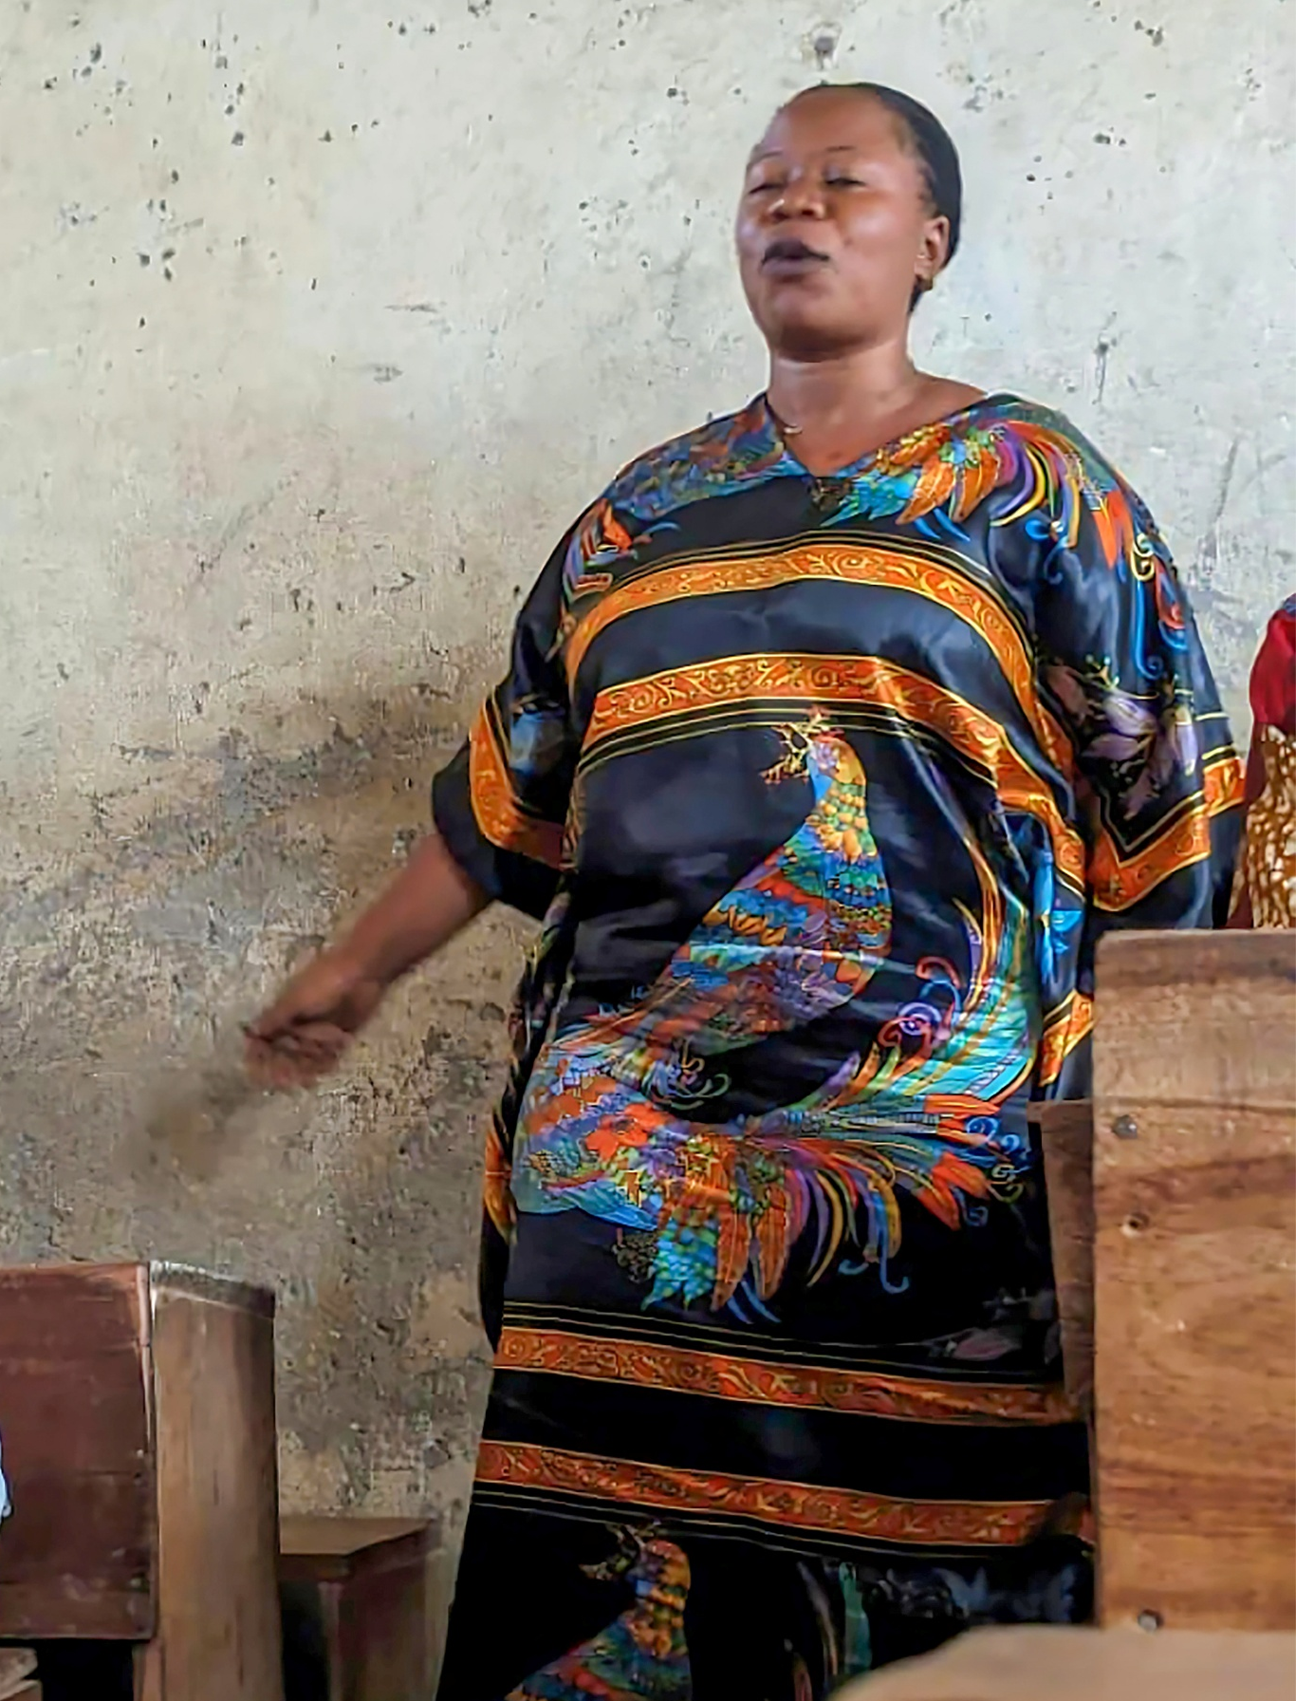
A liturgy for peace in DR Congo
Jesus be with us.
Jesus unite us.
Jesus forgive us,
And guide our feet
in the way of peace.
Amen.

