Slide 1
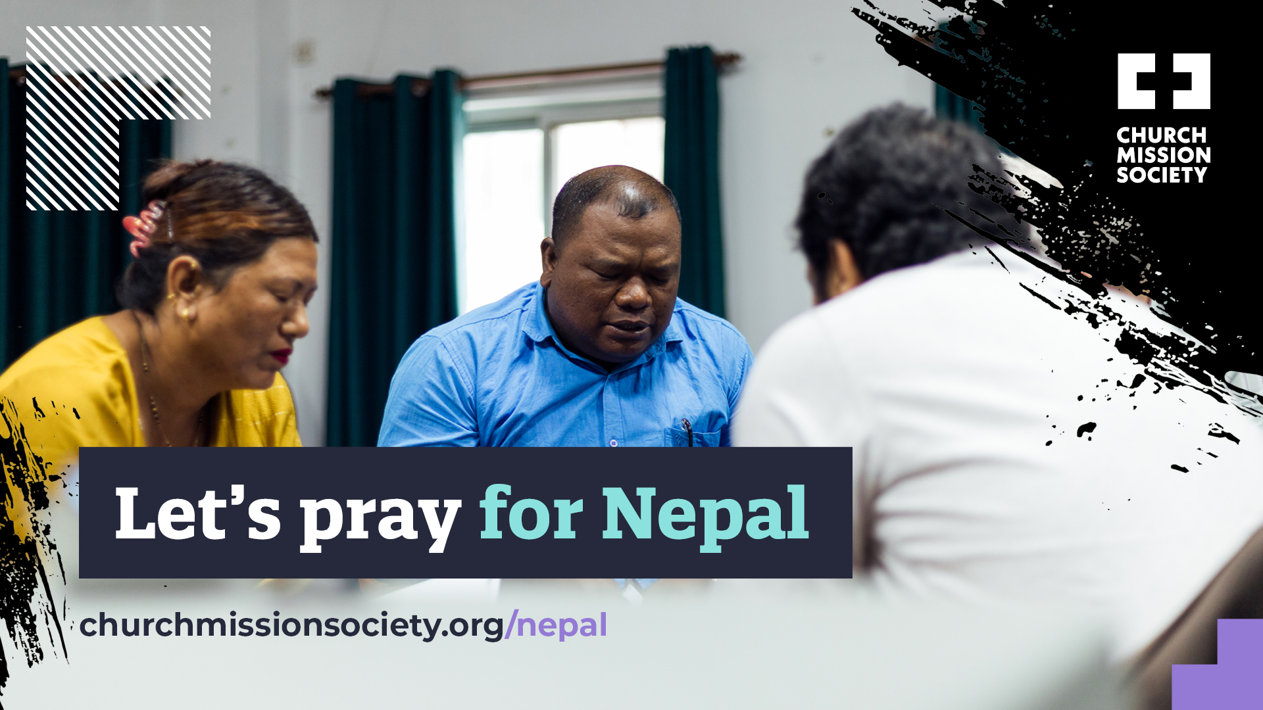

Slide 2
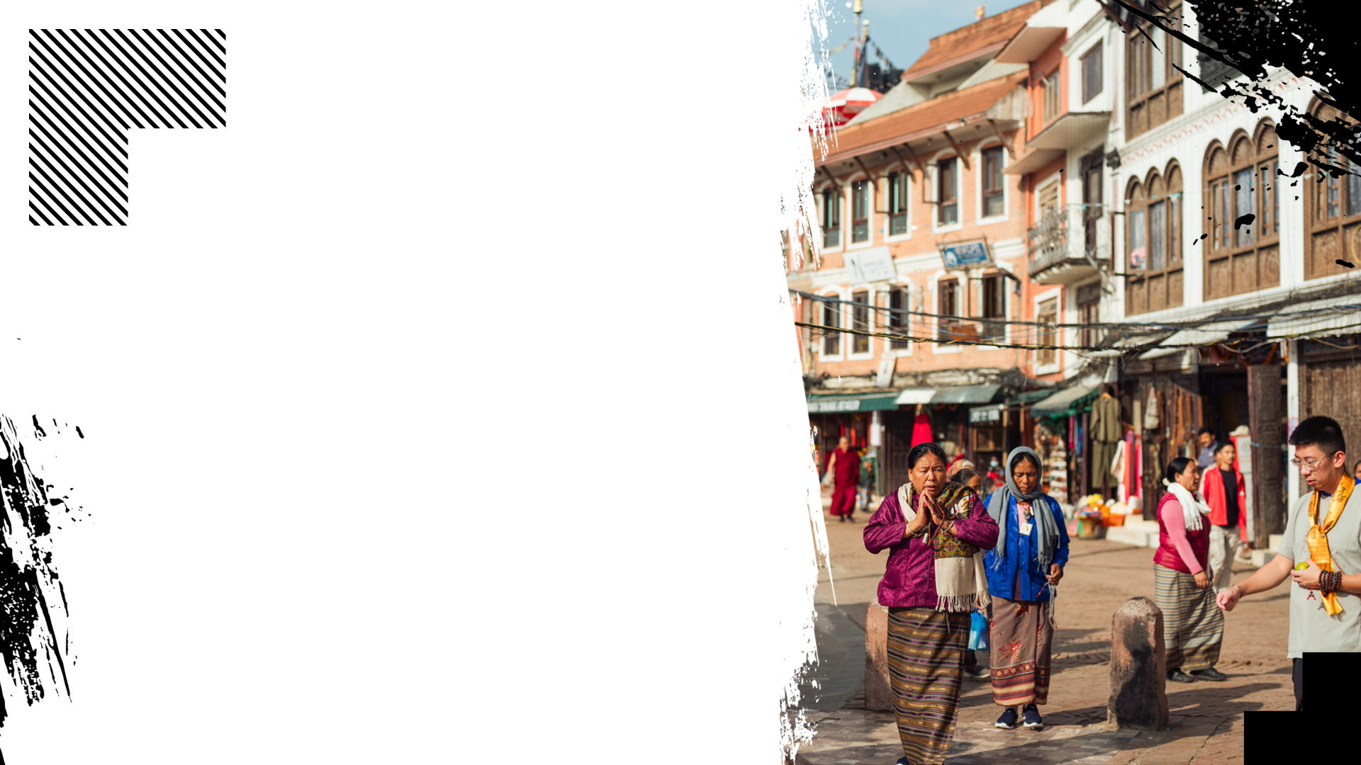

Let’s pray for Nepal
For church leaders,
many of whom face intense pressure
For the church across the country to grow strong
For new and future believers

Slide 3
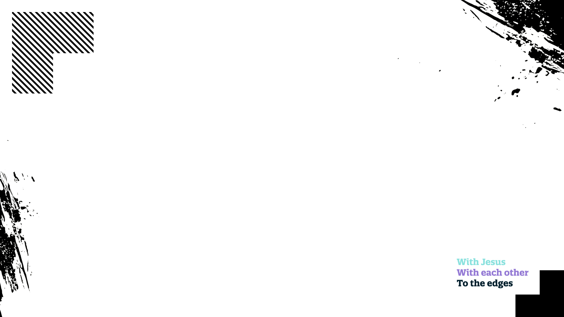
A liturgy for Nepal
As part of the body of Christ, we share in the suffering of Christians who are made to be outsiders, rejected by their loved ones and even attacked for choosing to follow Jesus.

Slide 4
A liturgy for Nepal
Standing with brothers and sisters in Nepal, in Asia and around the world, we pray for the outsiders.
On those who are met with suspicion and discriminated against because of their faith in Jesus,
Lord, have mercy.

Slide 5
A liturgy for Nepal
On those who are rejected by mother, father, sisters and brothers because they have said yes to Jesus,
Lord, have mercy.
On those whose lives are in danger because they follow you,
Lord, have mercy.

Slide 6

A liturgy for Nepal
Though they may be hard pressed on every side, let them not be crushed.
Though they may be perplexed, let them not be in despair.

Slide 7
A liturgy for Nepal
Though they may be persecuted,
let them not be abandoned.
Though they may be struck down,
let them not be destroyed.
Lord, have mercy.

Slide 8
A liturgy for Nepal
We lift to you the body of Christ in Nepal,
Those who are cast out for their faith,
Those who face intense pressure,
Those whose faith puts them in danger.
Lord, have mercy.

Slide 9
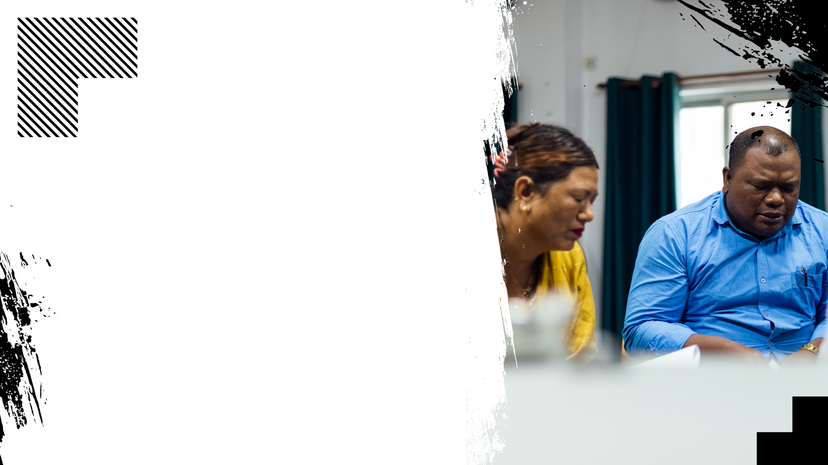
A liturgy for Nepal
Let us not forget our brothers and sisters who
are persecuted, nor take for granted the freedom we have to practise our faith.
Jesus, unite us as one body, as we all follow you. Amen.

