Slide 1

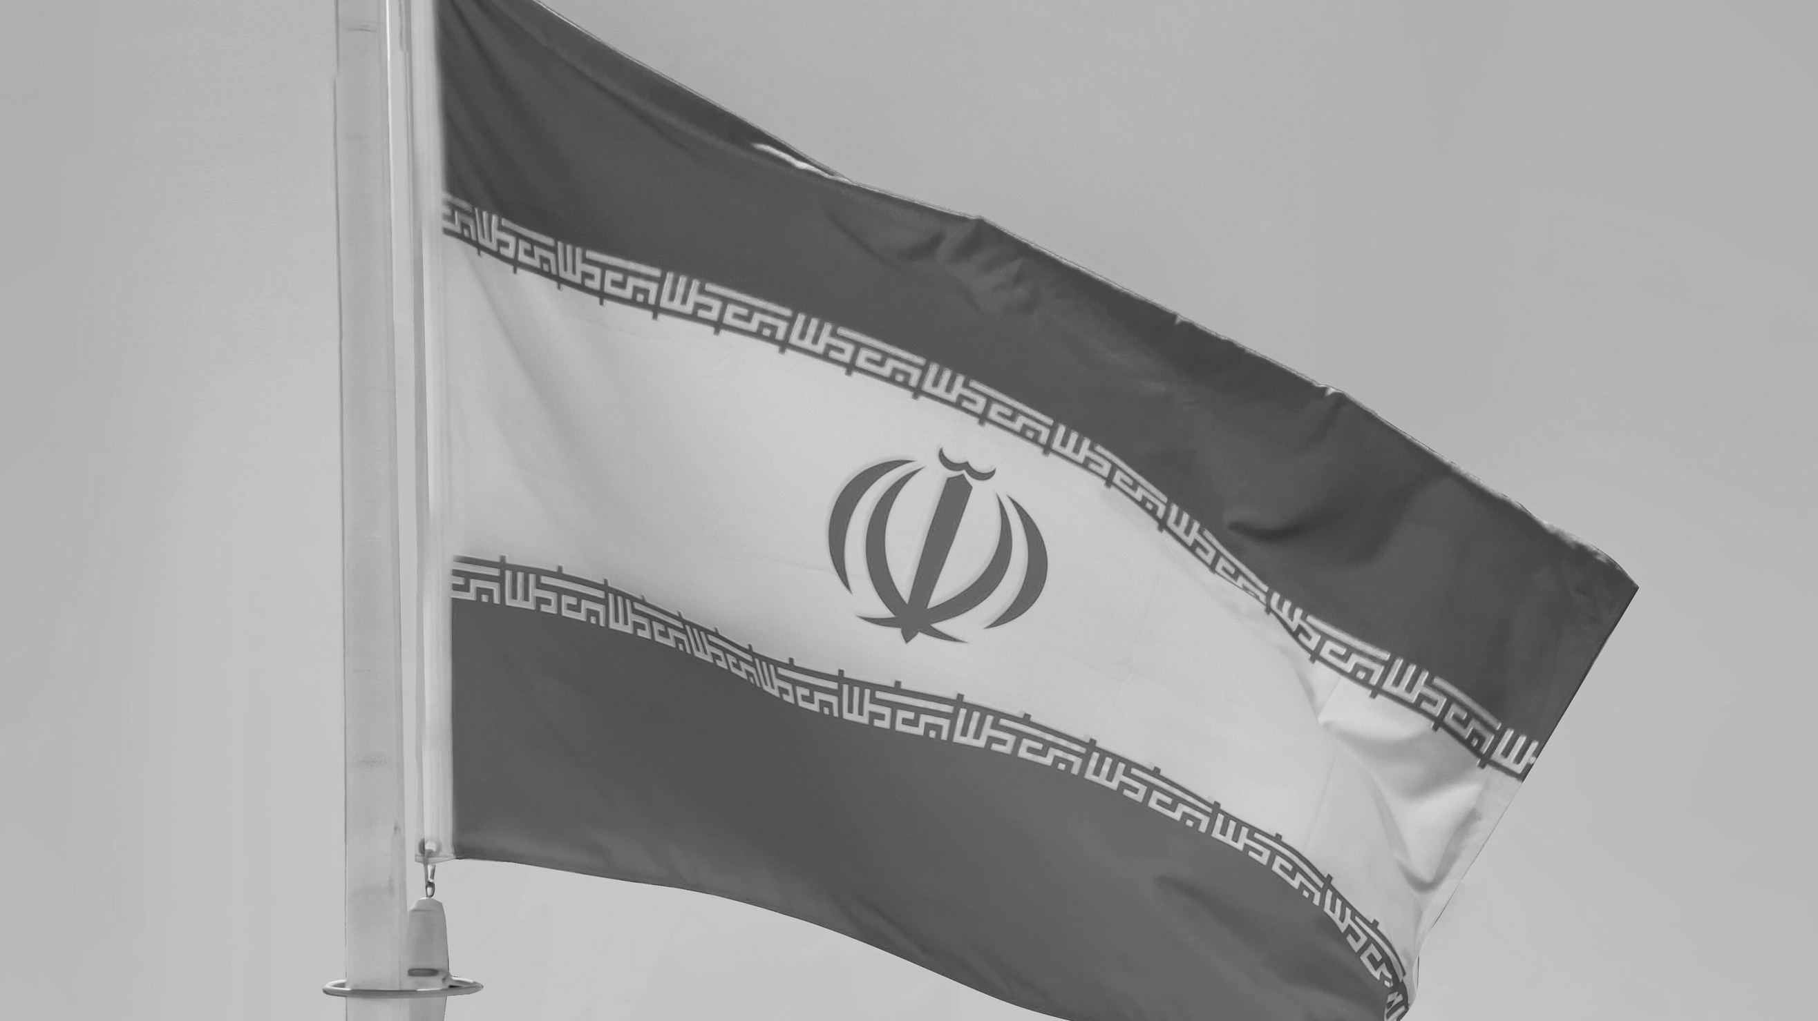



Crisis in Iran and the Middle East
Pray for peace, protection and wisdom:
  for diplomacy, dialogue and de-escalation: for violence to cease, for protection from harm and for peace in Iran, Lebanon and across the Middle East
  for respect for human rights and the dignity of God's children to prevail
  for leaders and decision-makers worldwide to act justly, quickly and decisively to provide much-needed practical support for suppressed civilians

Slide 2
Crisis in Iran and the Middle East
Pray for justice and freedom:
  for the Lord's protection for Christians imprisoned in Iran on account of their faith and for them to soon be released
  for conditions allowing freedom of religion in Iran, including for all Christians to be permitted to gather for worship freely and establish churches in Iran
  that Christians across the Middle East would not face increased persecution because of heightening instability

Slide 3
Crisis in Iran and the Middle East
Pray for Iranians in exile:
  for Iranians living outside the country who long to return to live or to visit, pray they would soon be able to return without fear
  for Iranians who have been forced to flee in recent years, and are ‘in limbo’ seeking asylum and safety in other countries

Slide 4
Crisis in Iran and the Middle East
Pray for Christian witness:
  for God’s light to shine through the church in Iran, bringing true freedom, healing, dignity and hope
  thanking God for the growing church in Iran, pray for the Body of Christ in Iran to thrive
  that Christians in Iran, Lebanon and across the Middle East would be a compelling testimony to others at this time of turmoil, pointing more and more of God's children to the Lord

Slide 5
Crisis in Iran and the Middle East
Pray for Lebanon:
  for the large number of displaced people who are now living in the streets, including the Syrian community facing increasing hardship and prejudice
  for the church in Lebanon, that it will be strengthened and equipped to continue helping those in need, and those sensing in a time of crisis that the church offers a different hope
  for peace, especially protection from civil conflict between Sunni, Shia, and Christian communities

